Slide 3
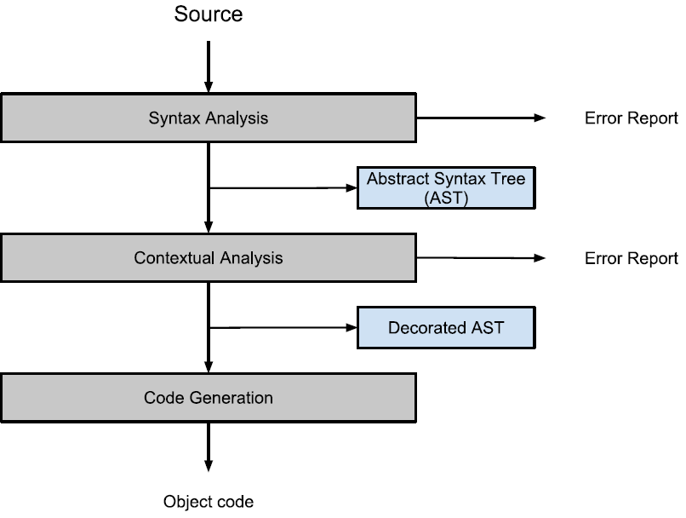
Compiler
The purpose of the compiler
  MASSIVE to C#
Compiler components
  Syntactic analysis
  Contextual analysis
  Code generation

Slide 4
Syntactic analysis
Divided into two parts
  Scanning
    Recognizing tokens in input according to language keywords
    Examples: “+” and “=” are operator tokens.
  Parsing
    Recognizing phrase structure of tokens
    Building an abstract syntax tree

Slide 5
Scanner implementation
The first method scans according to starters
  If letter → identifier token
  If number → digit token
  If operator → operator token
If the input is saved as an identifier:
  Token class searches for matching keywords
    If no match is found, input remains an identifier
    If there is a match, the token class changes the input to the right token
  Example: if the identifier spells “for”, the token class recognize it as a keyword, and changes it to a for-token

Slide 6
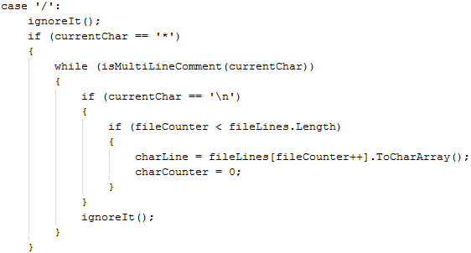
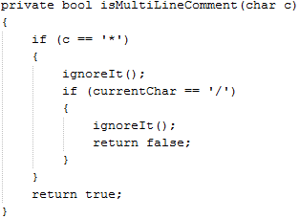
Scanner implementation
Comments, spaces, end-of-lines & indents
  Not saved as tokens
  Example: ignores multiline comments

Slide 7
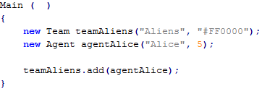
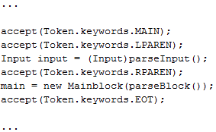
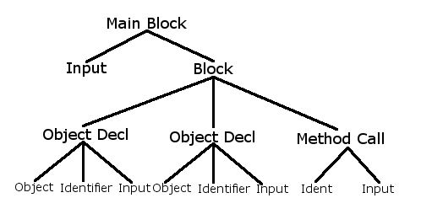
Parser implementation
Checks grammar and builds AST
  Each token has a parsing method
    Generates small subtrees and adds them to the AST
  Example: parse main block method

Slide 8
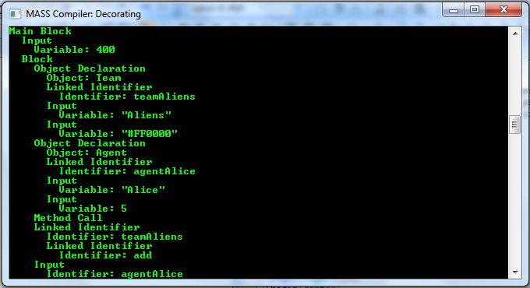
The abstract syntax tree
Convenient way of representing the phrases
  Easy to traverse with visitors
  Can be printed with a pretty-printer for good overview

